Slide 1
Bibliography ——ENG 1430 (Ⅱ)

Slide 2
Game Time!
Notes:
https://quizizz.com/admin/quiz/660559c4fc0d28221de0d50d?source=quiz_share

Slide 3
About “APA”

Slide 4
Citation
01
In-text
02
Full

Slide 5
Citation
1
in-text

Slide 6
Citations go in the (middle/ ending) of your essays
APA style requires that you cite in the body of your essay the source of a fact, idea, quote, or datum you have borrowed. The way you do this is the parenthetical citation – which is a fancy way of saying a citation in parentheses ( ). The elements of the parenthetical citation are easy: [direct quotation]
Here’s a sample:
(author, year of publication, page/para.)
“It has been argued that milk chocolate tastes better”
(Smith, 2001, p. 163).
Gordon Coleman, “In-text Citation in APA Style: Notes Sheet, Exercise, Answer Key”, https://urls.bccampus.ca/35.

Slide 7
“It has been argued that milk chocolate tastes better” (Smith, 2001, p. 163).
Each parenthetical citation must correspond to a full citation in your reference list at the end of your essay. In this case, if we looked in the reference list we might see something like this:
Smith, J.T. (2001). A comparison of milk and dark chocolate. Journal of Chocolatology, 4, 134-167.
Gordon Coleman, “In-text Citation in APA Style: Notes Sheet, Exercise, Answer Key”, https://urls.bccampus.ca/35.

Slide 8
If you are referring to the whole document or article, a page number is not necessary. | (Smith, 2001)
For two authors, use an ampersand. | (Smith & Jones, 2004)
If there are more than 3 authors, use “et al.” | (Smith et al., 1996, p. 345)
The author can be a group or institution. | (Simon Fraser University Library, 2004, p. 2)
If there is no author, you sometimes use the title of the item/article/webpage as author. If it is very long, use the first few words. | Newspaper article: (“Study finds”, 2003) Book or report: (Annual Report, 2001)
Gordon Coleman, “In-text Citation in APA Style: Notes Sheet, Exercise, Answer Key”, https://urls.bccampus.ca/35.

Slide 9
More than one item by the same author in the same year? Distinguish them with a, b, c. | (Smith, 2001a, p. 45)
For long web documents with no page numbers, give the section and then paragraph. | (Jones, 2002, Introduction section, para. 2)
Two citations in one set of parentheses: different resources same author | (Jones, 2002, p. 45; Smith, 1999, p. 67) (Jones, 1999, 2002)
Gordon Coleman, “In-text Citation in APA Style: Notes Sheet, Exercise, Answer Key”, https://urls.bccampus.ca/35.
Notes:
https://quizizz.com/admin/quiz/67f915afb7455dcd2995526b

Slide 10
Citation
2
full

Slide 11
Journal article

Slide 12
Journal article – find the errors

Slide 13
Journal article – find the errors
1
2
3
4

Slide 14
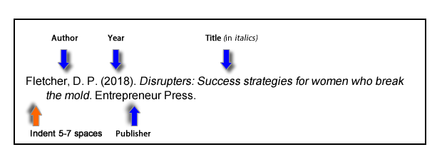
Book reference
Basic Format for Books
Author, A. A. (Year of publication). Title of work: Capital letter also for subtitle. Publisher Name. DOI (if available)
Stoneman, R. (2008). Alexander the Great: A life in legend. Yale University Press.

Slide 15
Edited Book reference
Author
Year
Book’s name
Publisher
Edit times
DOI

Slide 16
Book reference – Chapter in an edited book
Book’s editor
(First name. Last name)
Chapter’s Author
Year
Chapter’s name
Book’s name
Edit times
Chapter’s page
Publisher

Slide 17
Book chapter – find the errors

Slide 18
Book chapter – right version
1
2
3
4

Slide 19
Webpage or Piece of Online Content
If the page names an individual author, cite their name first:
Lastname, F. M. (Year, Month Date). Title of page. Site name. URL
Price, D. (2018, March 23). Laziness does not exist. Medium. https://humanparts.medium.com/laziness-does-not-exist-3af27e312d01
If the resource was written by a group or organization, use the name of the group/organization as the author. Additionally, if the author and site name are the same, omit the site name from the citation.
Group name. (Year, Month Date). Title of page. Site name. URL
American Society for the Prevention of Cruelty to Animals. (2019, November 21). Justice served: Case closed for over 40 dogfighting victims. https://www.aspca.org/news/justice-served-case-closed-over-40-dogfighting-victims

Slide 20
Newspaper
Author, A. A. (Year, Month Day). Title of article. Title of Newspaper. URL
Guarino, B. (2017, December 4). How will humanity react to alien life? Psychologists have some predictions. The Washington Post. https://www.washingtonpost.com/news/speaking-of- science/wp/2017/12/04/how-will-humanity-react-to-alien- life-psychologists-have-some-predictions

Slide 21
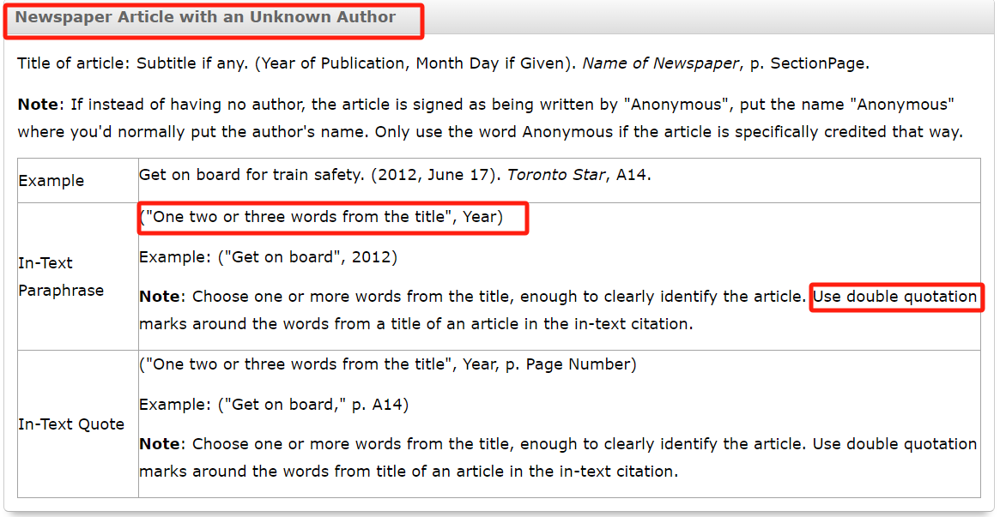

Slide 22
Exercise
Time

Slide 23
Padlet
https://padlet.com/linpen/bibliography-xpvsvd8p54ic5h4s

Slide 24
C
Question 1
a. Morrison, Toni. Beloved. New York: Vintage Books, 1987. b. Morrison, Toni. (1987). Beloved. Vintage Books. c. Morrison, T. (1987). Beloved. Vintage Books. d. Morrison, T. (1987). Beloved. New York, NY: Vintage Books.
G.

Slide 25
A
Question 2
Choose the correct APA citation for a newspaper article.
a. Alvarez, L. (2005, August 30). Storm batters Gulf Coast: New Orleans suffers. The New York Times, p. A1.
b. Alvarez, Linda. "Storm Batters Gulf Coast: New Orleans Suffers." The New York Times, August 30, 2005, p. A1.
c. Alvarez, Linda. (2005). Storm Batters Gulf Coast: New Orleans Suffers. New York Times, A1.
d. Alvarez, L. Storm Batters Gulf Coast. New York Times, 30 Aug. 2005, A1.
G.

Slide 26
D
Question 3:
Choose the correct APA citation for an article from a library research database.
a. Smith, J. The effects of sleep on memory consolidation. Journal of Psychology. 2020; 15(2): 45–60. doi:10.1234/jpsyc.2020.01502
b. Smith, J. (2020). The effects of sleep on memory consolidation. Journal of Psychology. 15(2), 45–60.
c. Smith, J. (2020). The effects of sleep on memory consolidation, Journal of Psychology, vol. 15, no. 2, pp. 45–60.
d. Smith, J. (2020). The effects of sleep on memory consolidation. Journal of Psychology, 15(2), 45–60. https://doi.org/10.1234/jpsyc.2020.01502
G.

Slide 27
Question 4: Write an in-text citation for it.
That dogs display an aversion to rubber ducks was first discovered by behaviorist L. Summers (A. write in-text citation). The story of the discovery has become legendary among animal researchers:
“While conducting an obedience trial in my backyard, I accidentally dropped my son’s rubber duck onto the field. Every dog in the competition immediately fled the scene, tails tucked between their legs (B. write in-text citation).”
Summers, L. (2012). Strange avoidance patterns in Canis lupus familiaris. Journal of Domestic Animal Behavior, 45, 112-119.
Summers, L. (2015). Through a Dog’s Eyes: New Frontiers in Behavior Research. Boston: Beacon Press, p. 89.

Slide 28
Answer:
That dogs display an aversion to rubber ducks was first discovered by behaviorist L. Summers (2012). The story of the discovery has become legendary among animal researchers:
“While conducting an obedience trial in my backyard, I accidentally dropped my son’s rubber duck onto the field. Every dog in the competition immediately fled the scene, tails tucked between their legs (Summers, 2015, p. 89).”
Summers, L. (2012). Strange avoidance patterns in Canis lupus familiaris. Journal of Domestic Animal Behavior, 45, 112-119.
Summers, L. (2015). Through a Dog’s Eyes: New Frontiers in Behavior Research. Boston: Beacon Press, p. 89.

Slide 29
½ inch: 1.27 cm
Sources from owl.purdue.edu

Slide 30
Answer:
That dogs display an aversion to rubber ducks was first discovered by behaviorist L. Summers (2012). The story of the discovery has become legendary among animal researchers:
“While conducting an obedience trial in my backyard, I accidentally dropped my son’s rubber duck onto the field. Every dog in the competition immediately fled the scene, tails tucked between their legs (Summers, 2015, p.89).”
While conducting an obedience trial in my backyard, I accidentally dropped my son’s rubber duck onto the field. Every dog in the competition immediately fled the scene, tails tucked between their legs. (Summers, 2015, p. 89)
Summers, L. (2012). Strange avoidance patterns in Canis lupus familiaris. Journal of Domestic Animal Behavior, 45, 112-119.
Summers, L. (2015). Through a Dog’s Eyes: New Frontiers in Behavior Research. Boston: Beacon Press, p. 89.

Slide 31
Question 5: Write an in-text citation for it.
The unexpected hostility of pandas toward disco music was initially met with skepticism. However, several investigations (A.&B. write in-text citation) have now demonstrated that exposure to disco causes stress behaviors in pandas. A detailed study by the Global Panda Foundation (C. write in-text citation) found that pandas react most strongly to fast-tempo beats. Meanwhile, a DJ from Berlin insists that pandas merely dislike “bad disco.” “They know quality just like any good Berliner!” he writes (D. write in-text citation).
Thompson, M. A., & Lee, R. S. (2013). Behavioral changes in pandas exposed to rhythmic stimuli. Journal of Giant Panda Studies, 22(2), 87–95.
Thompson, M. A., Lee, R. S., & Becker, T. L. (2016). Effects of disco music on the emotional states of Ailuropoda melanoleuca. Journal of Giant Panda Studies, 25(3), 134–149. https://academicsearchcomplete.com
Global Panda Foundation. (2019). The beat factor: How pandas perceive tempo. https://www.globalpandafoundation.org/research/beatfactor.pdf
Klang, F. (n.d.). A DJ’s take on pandas and disco: Only the real stuff passes! http://www.djsoundstories.com/pandasdisco (para. 3)

Slide 32
Answer:
The unexpected hostility of pandas toward disco music was initially met with skepticism. However, several investigations (Thompson & Lee, 2013; Thompson et al., 2016) have now demonstrated that exposure to disco causes stress behaviors in pandas. A detailed study by the Global Panda Foundation (2019) found that pandas react most strongly to fast-tempo beats. Meanwhile, a DJ from Berlin insists that pandas merely dislike “bad disco.” “They know quality just like any good Berliner!” he writes (Klang, n.d., para. 3).
Thompson, M. A., & Lee, R. S. (2013). Behavioral changes in pandas exposed to rhythmic stimuli. Journal of Giant Panda Studies, 22(2), 87–95.
Thompson, M. A., Lee, R. S., & Becker, T. L. (2016). Effects of disco music on the emotional states of Ailuropoda melanoleuca. Journal of Giant Panda Studies, 25(3), 134–149. https://academicsearchcomplete.com
Global Panda Foundation. (2019). The beat factor: How pandas perceive tempo. https://www.globalpandafoundation.org/research/beatfactor.pdf
Klang, F. (n.d.). A DJ’s take on pandas and disco: Only the real stuff passes! http://www.djsoundstories.com/pandasdisco (para. 3)

Slide 33
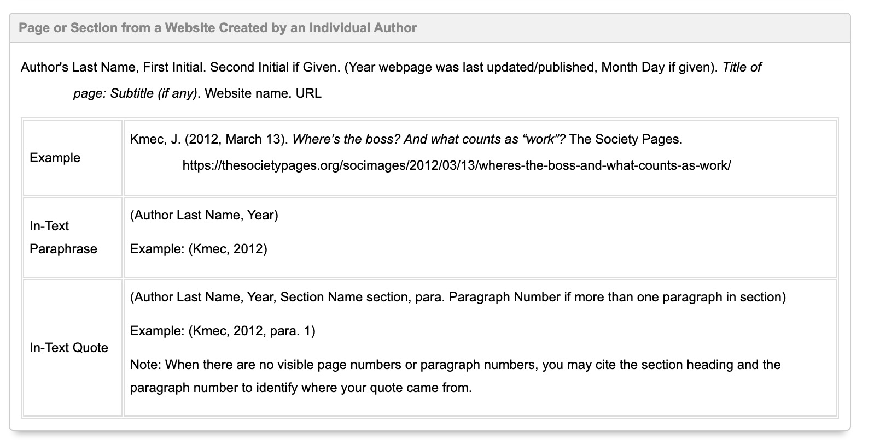
Klang, F. (n.d.). A DJ’s take on pandas and disco: Only the real stuff passes! http://www.djsoundstories.com/pandasdisco (para. 3)
Sources from columbiacollege-ca.libguides.com

Slide 34
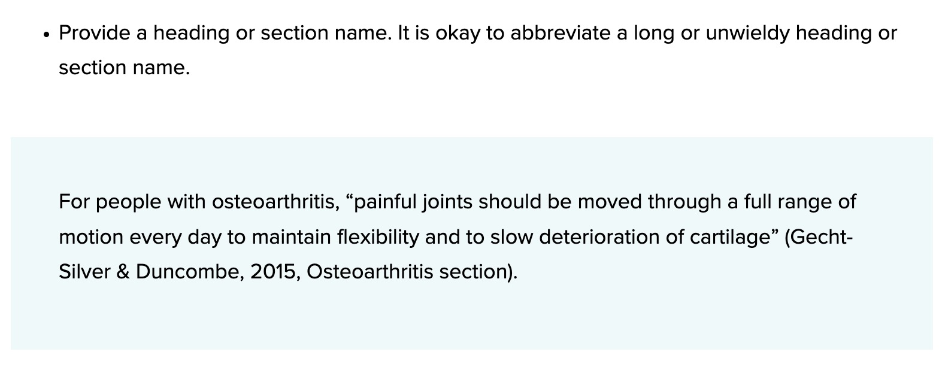
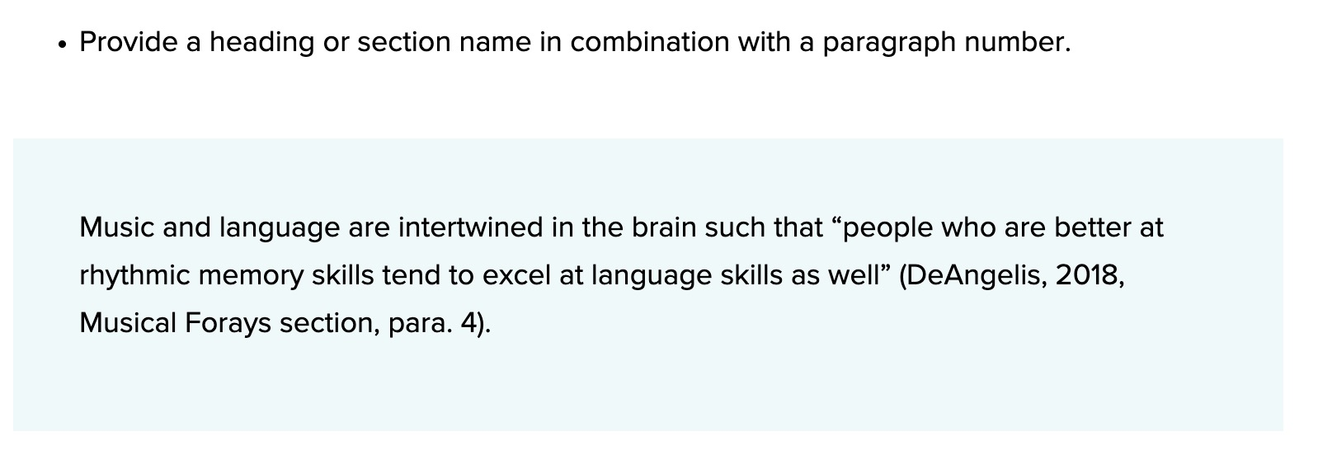
Direct Quotation of Material Without Page Numbers (In-text)
Sources from apastyle.apa.org

Slide 35
Answer:
The unexpected hostility of pandas toward disco music was initially met with skepticism. However, several investigations (Thompson & Lee, 2013; Thompson et al., 2016) have now demonstrated that exposure to disco causes stress behaviors in pandas. A detailed study by the Global Panda Foundation (2019) found that pandas react most strongly to fast-tempo beats. Meanwhile, a DJ from Berlin insists that pandas merely dislike “bad disco.” “They know quality just like any good Berliner!” he writes (Klang, n.d., para. 3).
Klang, F. (n.d.). A DJ’s take on pandas and disco: Only the real stuff passes! http://www.djsoundstories.com/pandasdisco (para. 3)
Klang, F. (n.d.). A DJ’s take on pandas and disco: Only the real stuff passes! http://www.djsoundstories.com/pandasdisco.
Klang, F. (n.d.). A DJ’s take on pandas and disco: Only the real stuff passes! (Section Name). http://www.djsoundstories.com/pandasdisco.

Slide 36
Question 6: Write a reference for it.

Slide 37
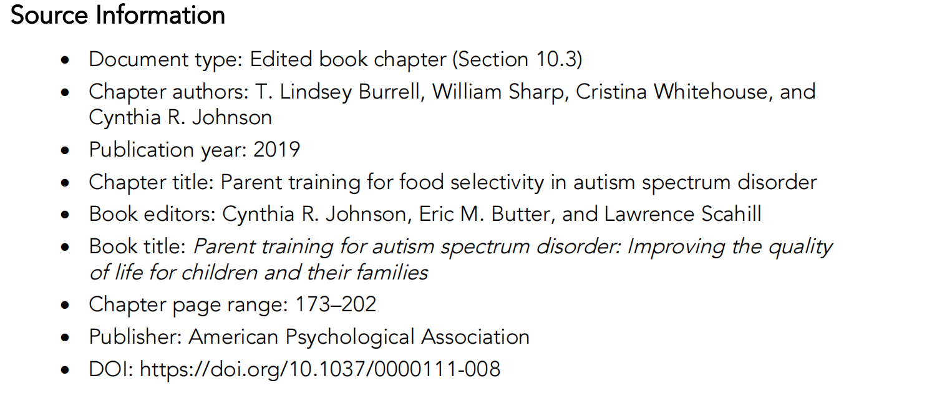
Question 7: Write a reference for it.

