Slide 1
How to Write an Argumentative Essay?
WORKSHOP

Slide 2

Game Time!
https://quizizz.com/admin/quiz/6827817b8138e46a067e0736

Slide 3
Q1: What is the most crucial element in the introduction part of an argumentative essay?
A. Providing detailed arguments for sub-points
B. Presenting the main argument and introducing the background
C. Incorporating famous quotes to enhance the literary style
D. Offering a detailed historical background introduction

Slide 4
Q1: What is the most crucial element in the introduction part of an argumentative essay?
A. Providing detailed arguments for sub-points
B. Presenting the main argument and introducing the background
C. Incorporating famous quotes to enhance the literary style
D. Offering a detailed historical background introduction

Slide 5
Q2. Which of the following is a correct example of the “Thesis Statement” in the introduction paragraph?
A. This article will discuss the impact of social media on teenagers.
B. Social media is a double-edged sword, having both advantages and disadvantages.
C. Although social media provides convenience, its negative effects on teenagers far outweigh its positive values.
D. In recent years, the popularity of social media has experienced explosive growth.

Slide 6
Q2. Which of the following is a correct example of the “Thesis Statement” in the introduction paragraph?
A. This article will discuss the impact of social media on teenagers.
B. Social media is a double-edged sword, having both advantages and disadvantages.
C. Although social media provides convenience, its negative effects on teenagers far outweigh its positive values.
D. In recent years, the popularity of social media has experienced explosive growth.

Slide 7
Q3:What is the standard structure of a main paragraph?
A. Sub-points + Evidence + Analysis and Explanation
B. Case Description + Personal Feelings + Summary
C. Data Listing + Counterarguments + Refutation
D. Introduction + Main Body + Conclusion

Slide 8
Q3:What is the standard structure of a main paragraph?
A. Sub-points + Evidence + Analysis and Explanation
B. Case Description + Personal Feelings + Summary
C. Data Listing + Counterarguments + Rebuttals
D. Introduction + Main Body + Conclusion

Slide 9
Q4. What are the correct steps for Counterargument?
A. Attack the opposing viewpoint + Emphasize the correctness of our own position
B. Acknowledge the reasonable points of the opposing side + Cite evidence to rebut + Reiterate our own argument
C. Ignore the opposing viewpoint + Add our own evidence
D. Directly deny the opposing side + Propose a new argument.

Slide 10
Q4. What are the correct steps for Counterargument?
A. Attack the opposing viewpoint + Emphasize the correctness of our own position
B. Acknowledge the reasonable points of the opposing side + Cite evidence to rebut + Reiterate our own argument
C. Ignore the opposing viewpoint + Add our own evidence
D. Directly deny the opposing side + Propose a new argument.

Slide 11
Q5. What is the main aim of the conclusion section?
A. Introduce new sub-points
B. Repeat all the evidence from the main body
C. Restate the main point and elevate the theme
D. Propose solutions that have not been discussed

Slide 12
Q5. What is the main aim of the conclusion section?
A. Introduce new sub-points
B. Repeat all the evidence from the main body
C. Restate the main point and elevate the theme
D. Propose solutions that have not been discussed

Slide 13
TABLE OF CONTENTS
01
02
03
What is an Argumentative Essay
Planning
Thesis
04
05
Body Paragraphs
Counterargument
& Conclusion
06
Editing

Slide 14
01
What is an Argumentative Essay?
What’s your opinion?

Slide 15

Argumentative (Persuasive) Essay
Definition: Persuade your readers to make a change
Mental Change: Shifting opinions, attitudes, beliefs…
Policy Change: Shifting an actual rule, law, or procedure…
An Example Topic:
Does a cat make a better pet than a dog?
It forces you to choose one side. No fence-sitting.
It’s narrow enough to argue in 3-6 body paragraphs.

Slide 16
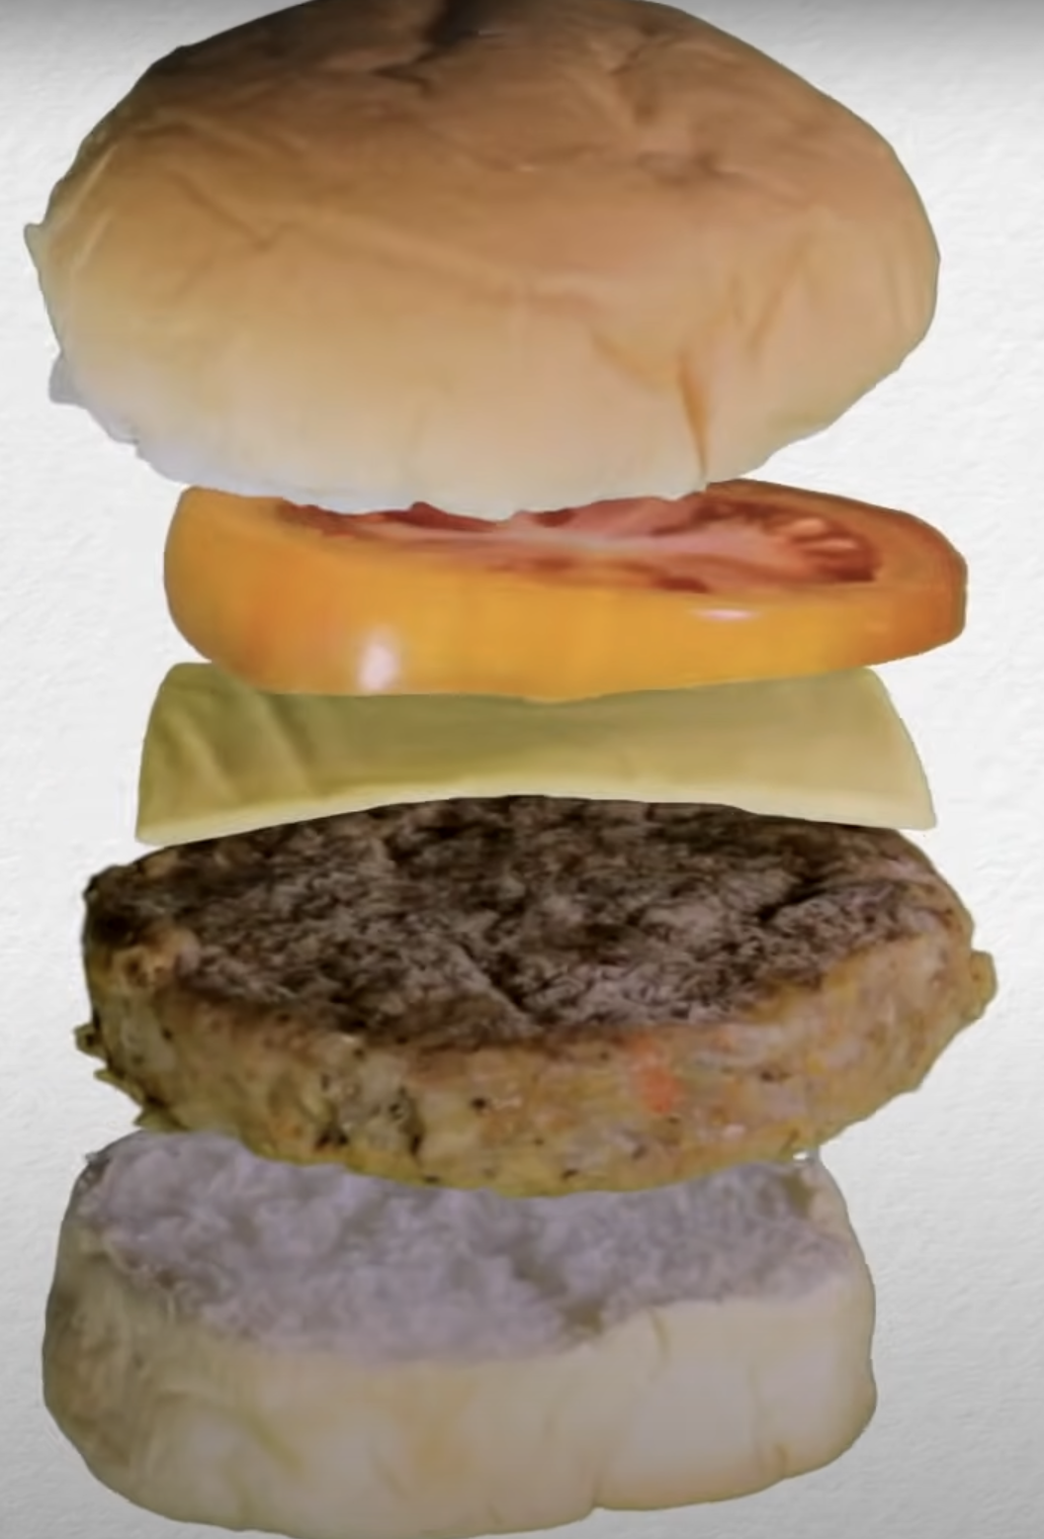
Structure
Introduction
Body Paragraph 1
Body Paragraph 2
Body Paragraph 3 (Counter)
Conclusion

Slide 17
02
Planning Before Writing

Slide 18
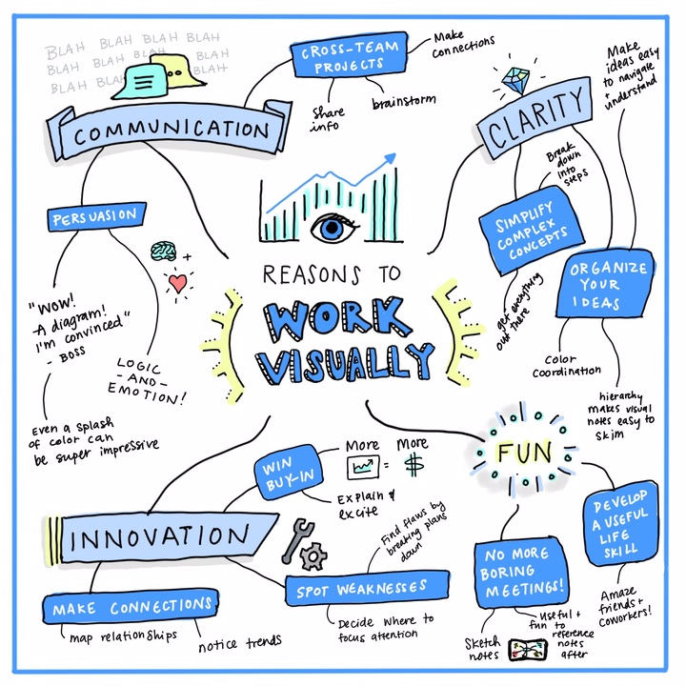
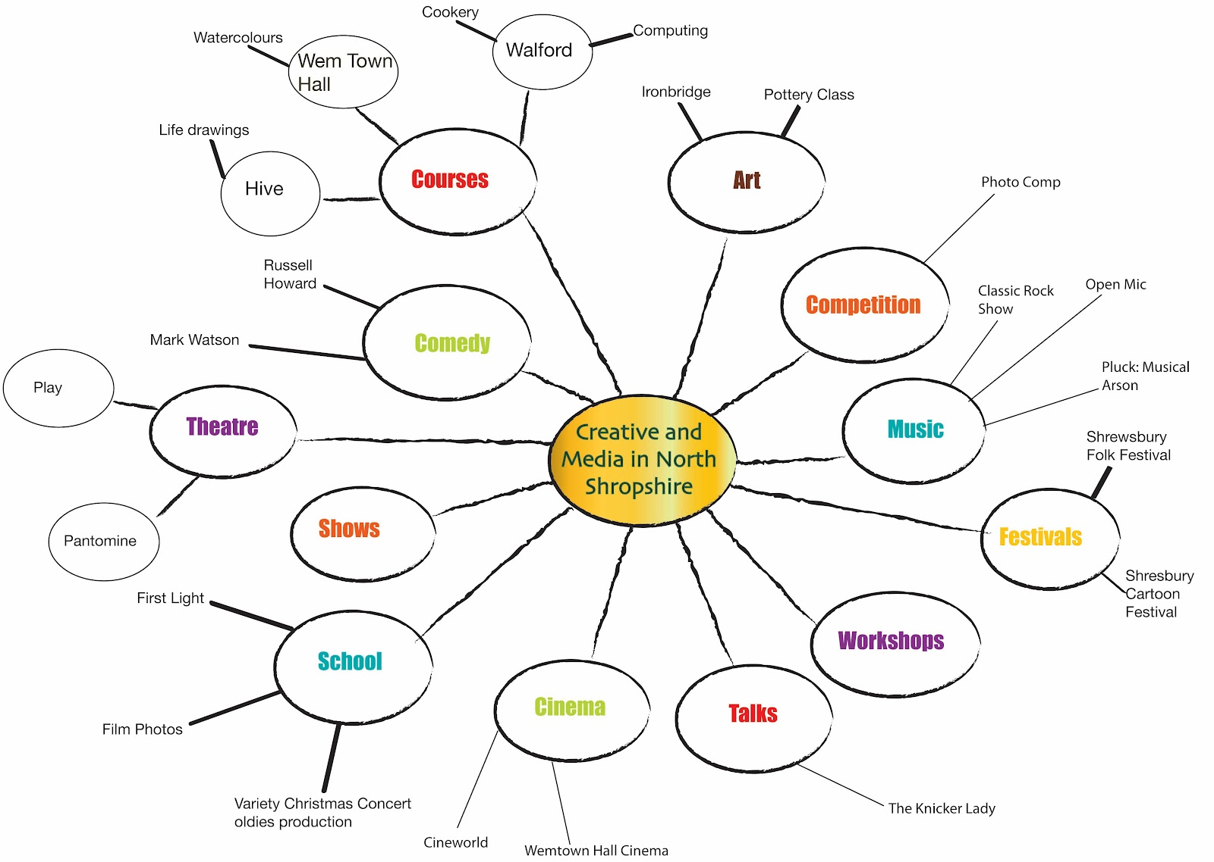
Planning Approach
Spider Diagram
Dump every idea that pops into your head without judging. Put the topic in the centre bubble, shoot branches for sub-ideas, then smaller bubbles for facts, examples, and sources.

Slide 19
Let’s try
Spider Diagram (1 min)

Slide 20
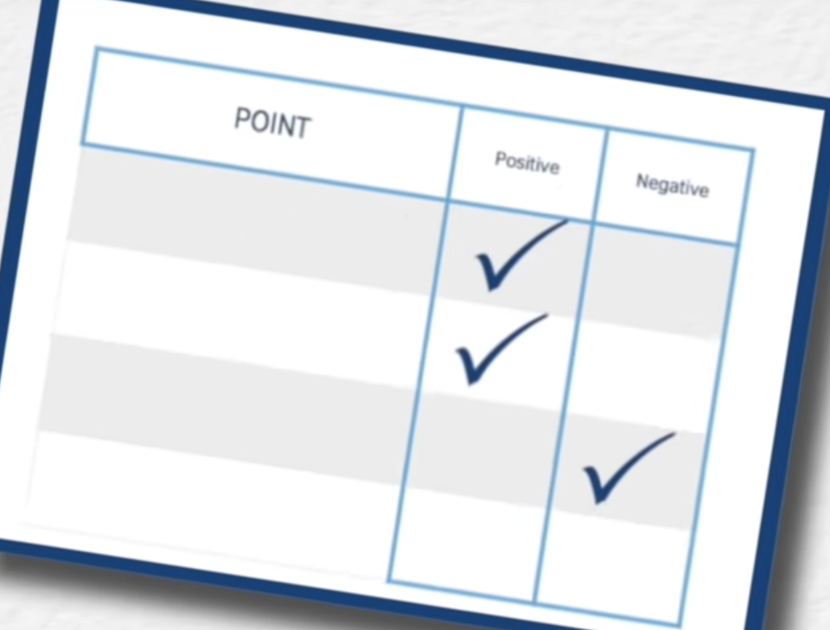
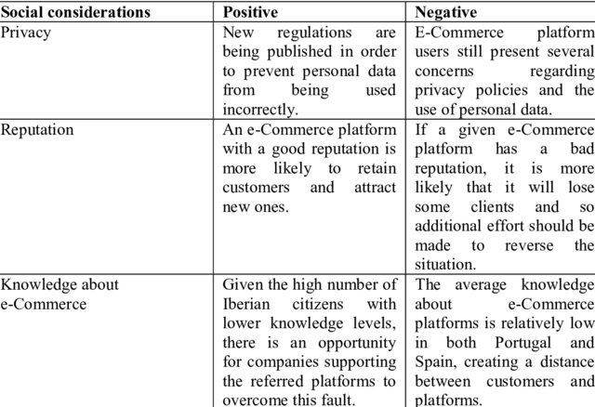
Planning Approach
Spider Diagram
Positive & Negative Table
List key points. Tick which side they help.

Slide 21
Positive & Negative Table
After finishing their bachelor’s degree, should Chinese students prefer pursuing a master’s abroad over staying in China?
本科毕业后，中国学生是否更应该选择出国读研？
Point / Evidence (论点/证据) | YES - go abroad 出国读研更好 | NO - stay in China 留在国内更好
独立能力、跨文化适应Independence | ✔️
就近照顾家庭 Family |  | ✔️
…
5 Minutes / within your group

Slide 22
Outline
Plan & Brainstorm & Research
Hook
Introduction
Background
Body 3 (Counter)
Thesis
Topic sentence
Conclusion
Body 1
Explanation
Evidence
Topic sentence
Reference
Body 2
Explanation
Evidence

Slide 23
03
Thesis Statement
Core of paper

Slide 24

How to write thesis statement?
立场 （中心论点）
分论点

Slide 25
How to write thesis statement?
Although + opposing point of view + your argument + because +
the reasons (main ideas) your argument is right.
Instead of using “although,” you could also use
even though, in spite of, despite, while, whereas
to show the same meaning.
Never use “but” with any of those words in the same sentence!

Slide 26
How to write thesis statement?
Although + opposing point of view + your argument + because +
the reasons (main ideas) your argument is right.
Although some argue that studying for a master’s degree in China is more cost-effective, Chinese graduates should pursue postgraduate study abroad because international programmes provide access to cutting-edge research facilities and provide the opportunity to gain independence from family.

Slide 27

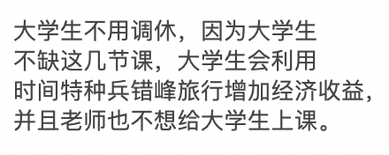









Thesis Statement
Clear
Specific
Arguable

Slide 28
04
Body Paragraphs

Slide 29
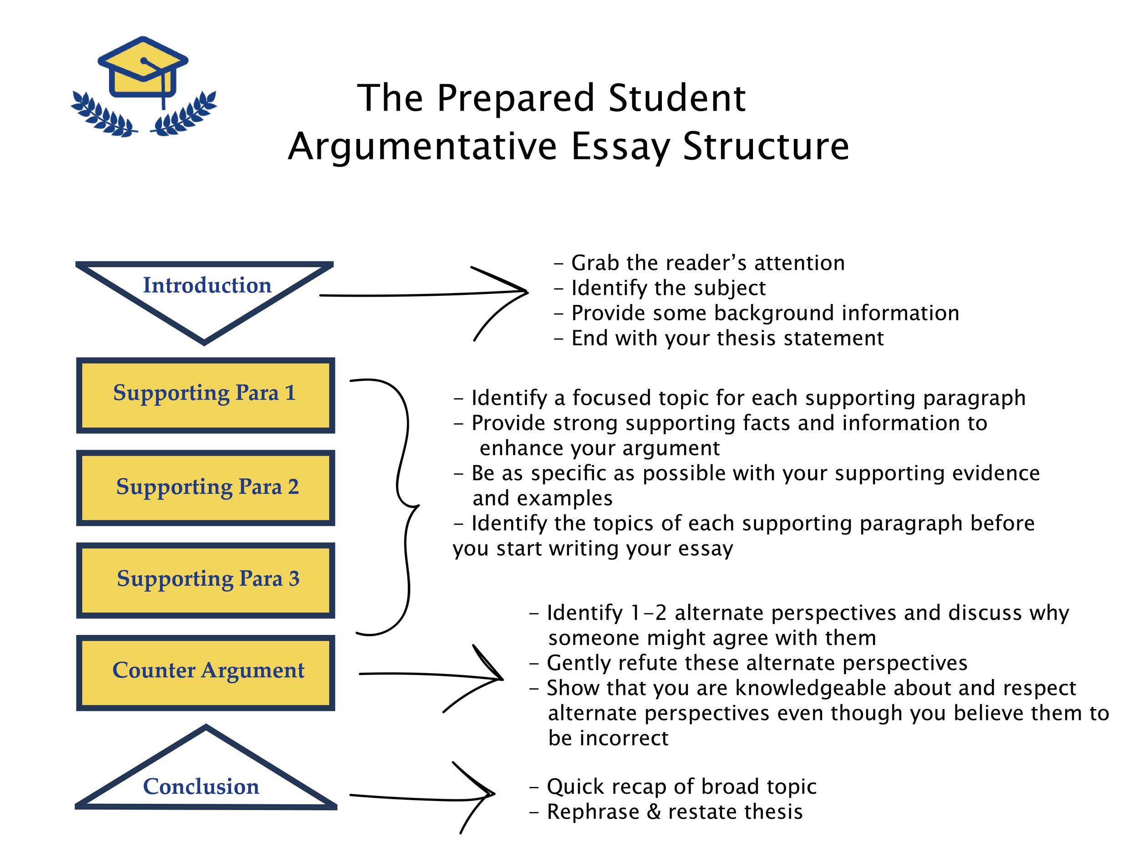
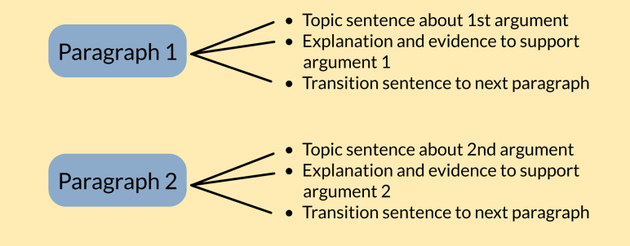
Paragraph 1 & 2

Slide 30
Effective Paragraph
Good writers have the ability to write clear and effective paragraphs. A paragraph cannot simply be “slopped” together, but rather there is a structure to develop an effective and cohesive paragraph.
Good writers should remember the MEAL Plan:
Main Idea
Evidence
Analysis
Link

Slide 31
Main idea
The main idea of a paragraph is called the topic sentence.
Everything in your paragraph must connect and support your topic sentence in order to be cohesive.
The topic sentence should appear near the beginning of the paragraph
The topic sentence for each paragraph should be directly related to the paper’s main idea or thesis.

Slide 32
For example, if the thesis statement for your essay is:
The University of Toledo should ban smoking on campus because of its negative effects on people and the campus.
Possible topic sentences for body paragraphs:
Smoking is directly connected to dangerous health problems.
Non-smokers should not be subjected to secondhand smoke.
By allowing smoking on campus The University is supporting unhealthy habits.
When people smoke they irresponsibly discard their cigarettes and ashes all over campus.

Slide 33
Evidence
After the main idea (the topic sentence) is stated, relevant evidence must be provided to support the debatable claim made in the topic sentence.
Ethos Pathos Logos
The forms of evidence:
Studies, reports, data, statistics, interviews, examples or
illustrations.

Slide 34
Evidence
School uniforms should be banned because they limit students’ freedom of expression. According to a survey by the National Student Rights Association (2022), 73% of high school students feel that uniforms prevent them from expressing their individuality. While some argue that uniforms promote discipline, studies show that there is no clear link between uniforms and academic performance. Therefore, schools should focus on creating inclusive environments without restricting students’ self-expression through clothing.
Evidence should be relevant and directly support the writer’s topic sentence and the thesis statement for the essay.
I just don’t think they are a good idea. Many people feel uncomfortable wearing the same thing every day. It’s boring, and students don’t like it. Also, uniforms are just not cool. I remember when I had to wear one and I didn’t like it at all. Everyone should be able to dress however they want. Uniforms are simply not necessary, and most students agree with that.
Topic sentence:
School uniforms should be banned because they are unfair to students.

Slide 35
Evidence
The writer may choose to present source evidence through summary, paraphrase, or direct quotation, and the writer may also use modes of development such as description, definition, example, analogy, cause and effect, or comparison and contrast.

Slide 36
Topic Sentence:
Smoking is directly connected to dangerous health problems
Evidence:
According to the Centers for Disease and Control, smoking
is the cause of almost 500,000 deaths a year in the United
States. The CDC also states, “More deaths are caused each
year by tobacco use than by all deaths from human
immunodeficiency virus (HIV), illegal drug use, alcohol use,
motor vehicle injuries, suicides, and murders combined”.

Slide 37
Analysis
Following the evidence, the writer must provide an analysis of the evidence that has been provided
Analysis is the writer’s evaluation, interpretation, judgment, or conclusion of how the evidence supports the paragraph’s main idea or topic
As the leading voice in the paper, the writer is required to explain how the audience is meant to interpret the evidence in the context of the writer's argument.

Slide 38
Analysis:
Evidence:
According to the Centers for Disease and Control, smoking
is the cause of almost 500,000 deaths a year in the United
States. The CDC also states, “More deaths are caused each
year by tobacco use than by all deaths from human
immunodeficiency virus (HIV), illegal drug use, alcohol use,
motor vehicle injuries, suicides, and murders combined”.
All evidence clearly states that smoking is dangerous to an
individual’s health and with the negative consequences, it is
difficult to believe that any university would support such a death
sentence.

Slide 39
Link
The final sentence or sentences of the paragraph link the current paragraph’s main idea to the main idea in the next paragraph.
Since most body paragraphs are going to be followed by another body paragraph, the writer should consider using transitional phrases that help to link paragraphs.
Use transitional words such as however, so, thus, still, despite, nonetheless, although, but, even though, or in spite of signal relationships between paragraphs and the relationship between the main ideas of all paragraphs.

Slide 40
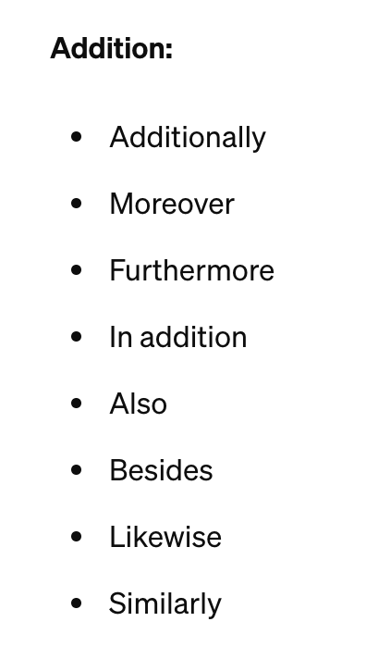
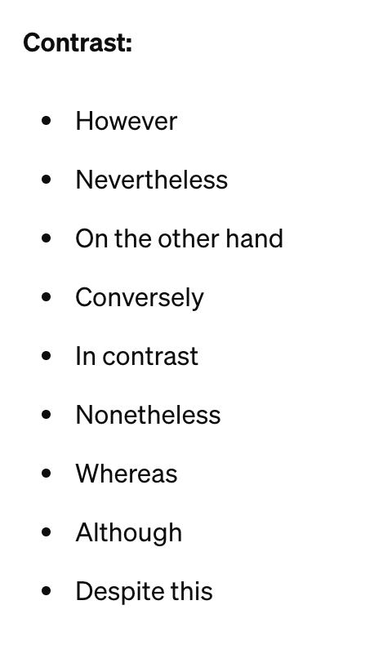
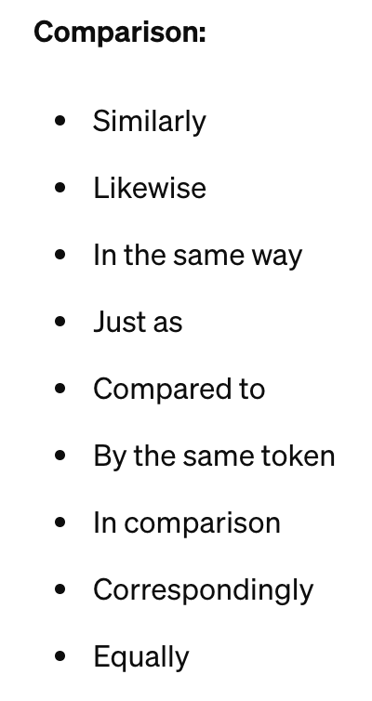
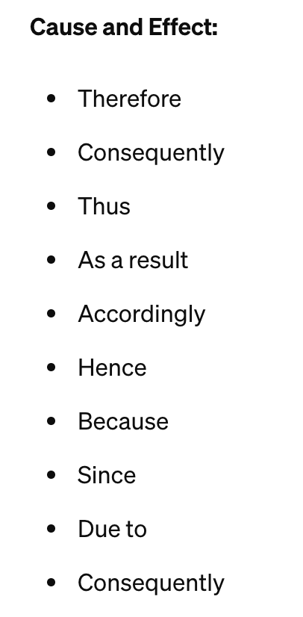
Transitional Phrase

Slide 41
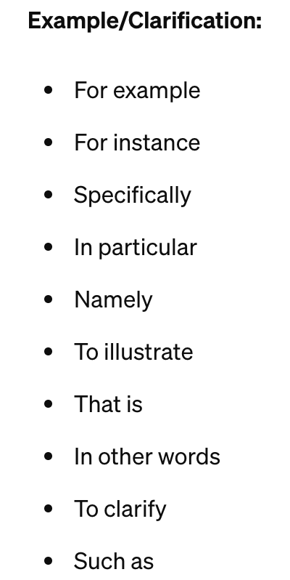
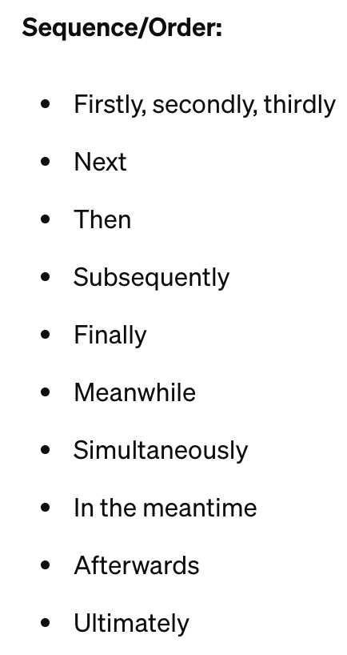
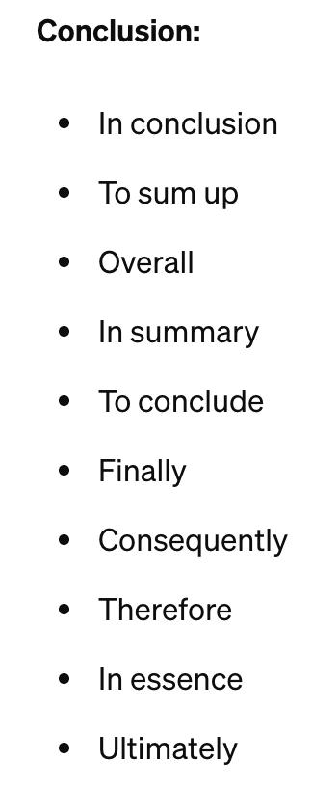
Transitional Phrase

Slide 42
Analysis:
All evidence clearly states that smoking is dangerous to an
individual’s health and with the negative consequences, it is
difficult to believe that any university would support such a death
sentence.
Link:
Not only does smoking cause serious health problems for the
individual, but it also effects others who choose not to smoke.
Topic Sentence of following paragraph:
Non-smokers should not be to subjected to second hand smoke.

Slide 43
MEAL
Smoking is directly connected to dangerous health problems. According to the Centers for Disease and Control, smoking is the cause of almost 500,000 deaths a year in the United States. The CDC also states, “More deaths are caused each year by tobacco use than by all deaths from human immunodeficiency virus (HIV), illegal drug use, alcohol use, motor vehicle injuries, suicides, and murders combined”. Evidence clearly shows that smoking is dangerous to an individual’s health and with such negative consequences, it is difficult to believe that any university would support such a death sentence. Not only does smoking cause serious health problems for the individual, but it also affects others who choose not to smoke.

Slide 44
05
Counterargument
& Conclusion

Slide 45
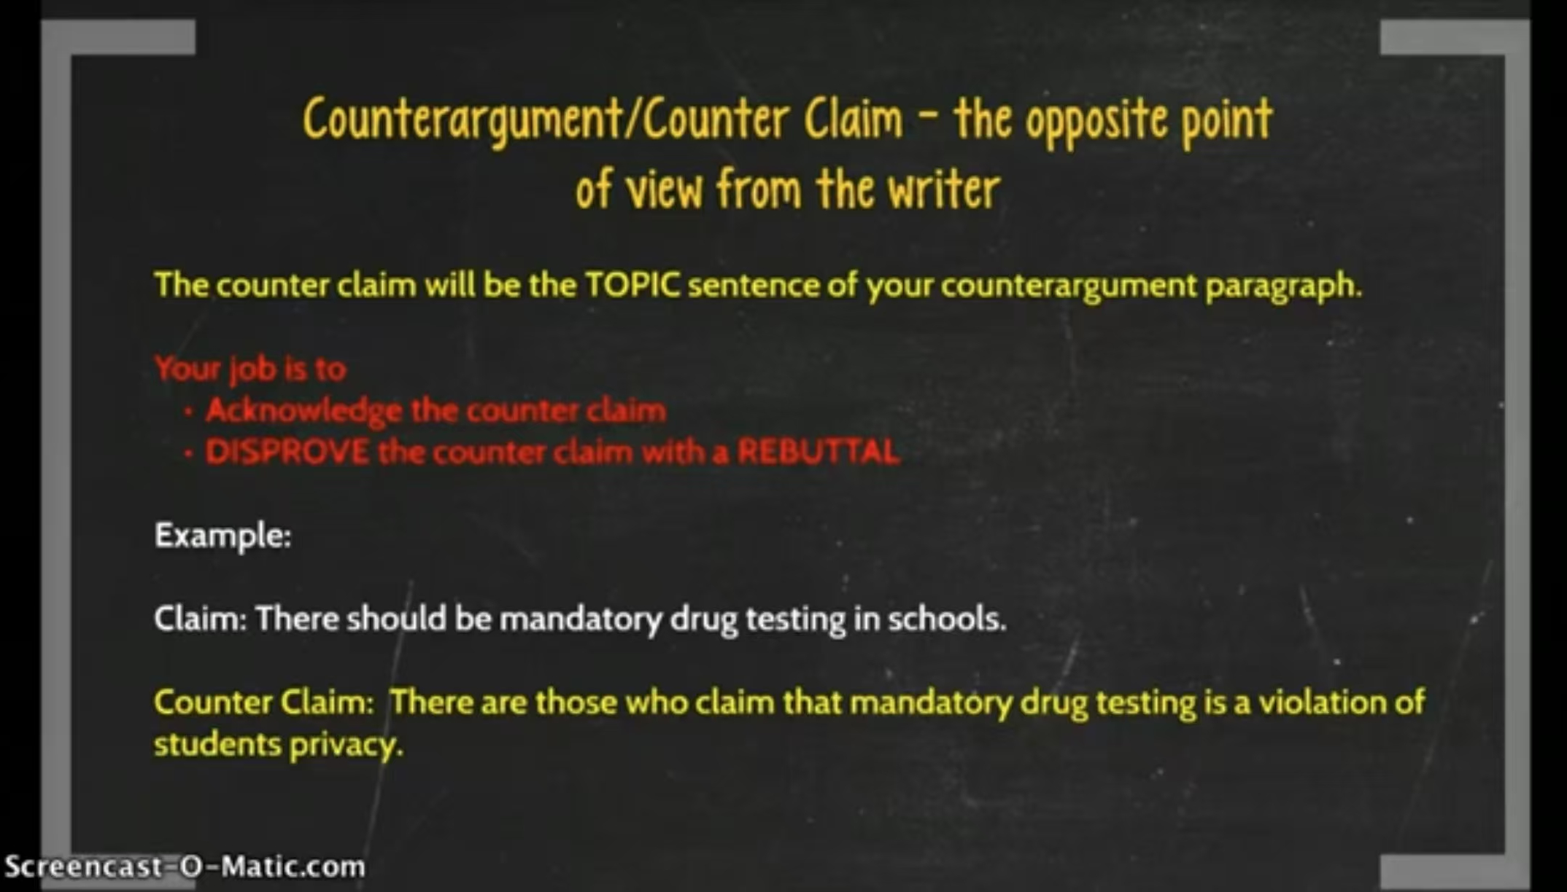
Counterargument - Video + Quizizz
https://quizizz.com/admin/interactive video/682752e3fa665a4210a634df?source=lesson_share
https://www.youtube.com/watch?v=6Ig32Ensl4I

Slide 46


Counter Paragraph
Show counter argument
But……
The fact is……
潜在反驳理由
反驳 反驳理由

Slide 47

Structure of Counter Paragraph
Opposing Argu
Topic Sentence 主题句
1 Sentence
Elaboration
Additional Information 支持主题句
1 Sentence
Fact, personal experience·······
Example
1～2 Sentences
Rebuttal
1 Sentence
Transitional 转折主题句
Elaboration
1 Sentence
Example
1～2 Sentences
呼应 Topic Sentence
解释 example 如何证实了TS
Link
1 Sentence

Slide 48
Conclusion
Link
和上一段接轨（In conclusion……)
Partly admit
先做一个让步
Restate own opinion
不要照搬 Thesis
Recommend future action
未来展望，升华主题
! Similar Length !

Slide 49
06
Editing
Final Check

Slide 50


Check List
实事求是
检查语法（推荐Grammarly）
词汇准确多样
是否连贯统一
内容是否完整，有没有偏题

Slide 51

Post-assessment
Should art and physical education courses be given the same importance as the core subjects?
https://padlet.com/zhengyax/padlet-nlepre2s2qq5serm

Slide 52
Post-assessment
Should art and physical education courses be given the same importance as the core subjects?

Slide 53
Any Question?

